Slide 1

Advanced Marketing
Network Analysis
Final Project
Gal Gritzerstein & Daniel Mandelbaum
PLAY

Slide 2
Spotify
Yoni.cohen@gmail.com
**************
Log in
Forgot password? Sign up for Spotify

Slide 3

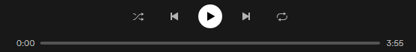
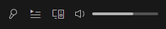
Spotify
Swedish company founded in 2006
The world's largest music streaming service provider
Over 381 million monthly active users
Including 172 million paying subscribers
BEFORE THEY ALL ARRIVE

Slide 4
OUR GOAL
Explore how we recommend our users to listen to new artists.
Log in
BEFORE THEY ALL ARRIVE

Slide 5



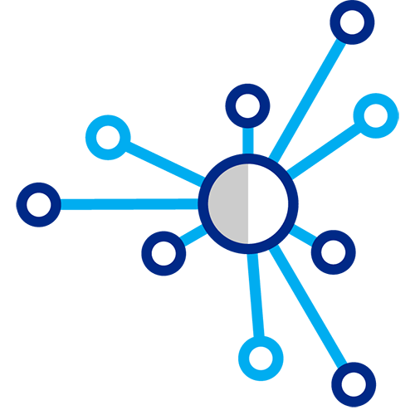



Research Approach
Creating Our dataset
Building The Network
Make Recommendations
Define
Potential New Artists
To Listen To
Downloading Yoni’s Data
EDA
BEFORE THEY ALL ARRIVE

Slide 6


Search
Downloading Yoni’s Data
PLAY
FOLLOWING
…
Our Data Sources:
Spotify API
- Yoni's Spotify data (in Json files)
Reporter 1
AVIRA

Slide 7
Search
Creating Our dataset
PLAY
FOLLOWING
…
All songs Yoni streamed in the recent year
Getting tracks data using API
Filtering out artists that Yoni heard less than 40 times
Filtering out streams that were played less than 30 seconds
Getting for each artist all related artists
2 Json files sent from Spotify by request
Track ID,
Artist ID,
Audio features,
Time
Etc.
with Spotify Algorithm
44 ARTISTS
Reporter 1
AVIRA

Slide 8
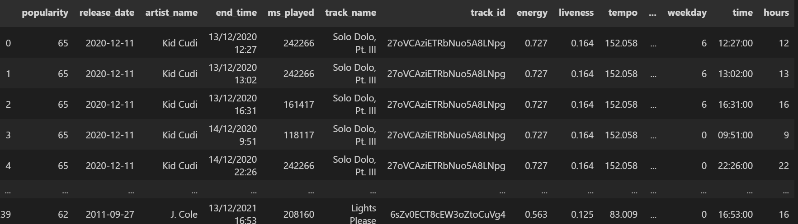
Search
Creating Our dataset
PLAY
FOLLOWING
…
Reporter 1
AVIRA

Slide 9
Search
Explanatory Data Analysis
PLAY
FOLLOWING
…
Artists Genres
Audio Features
Usage Time
Reporter 1
AVIRA

Slide 10
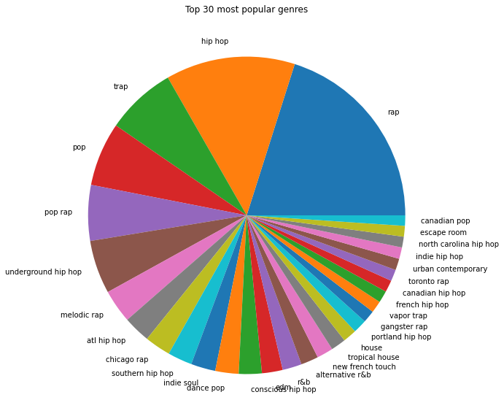
Top Genres
Hip hop
Rap
Trap
Pop
Pop rap
Juliana Trap
Rap Trap
Hip Rap
Trap Hop
Sylvie Pop
Notes:
Note: At the back of the logo there’s a loading gif

Slide 11
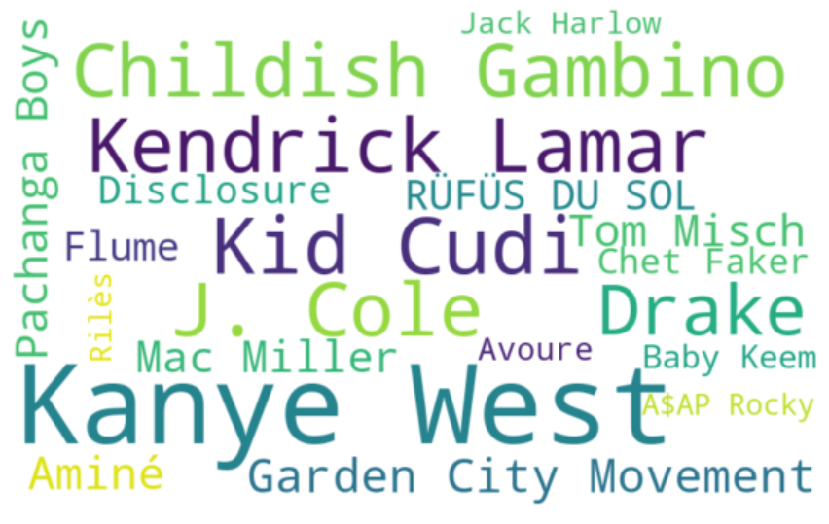
Artists Cloud
Notes:
Note: At the back of the logo there’s a loading gif

Slide 12
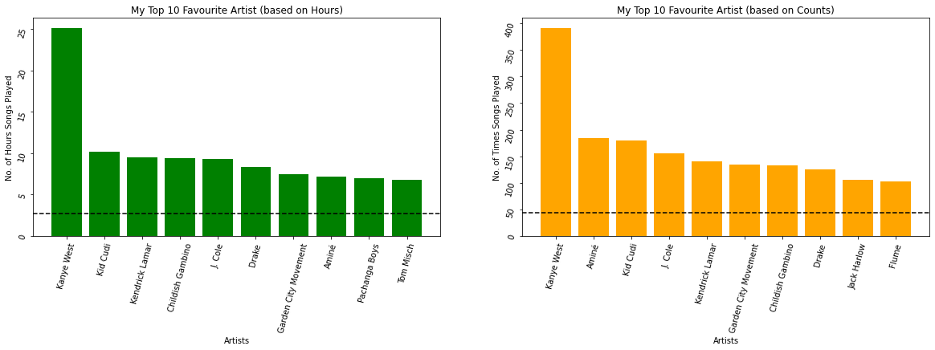
Top 10 Artists
Notes:
Note: At the back of the logo there’s a loading gif

Slide 13
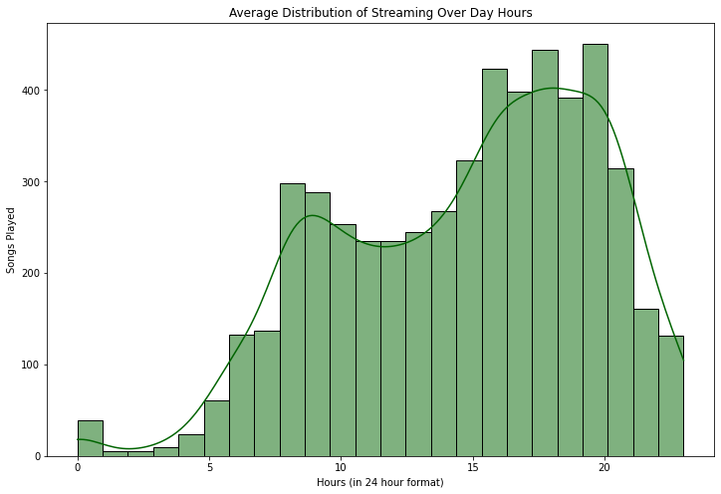
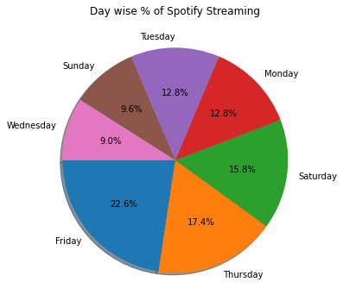
Yoni’s Streaming Times
Notes:
Note: At the back of the logo there’s a loading gif

Slide 14
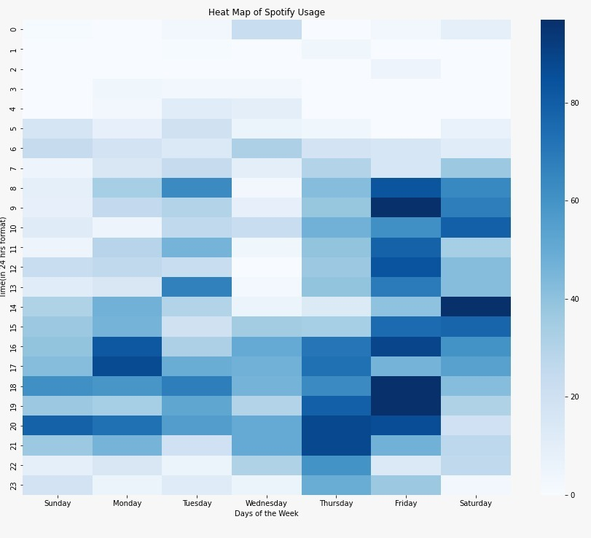
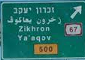

Yoni’s Streaming Times
Notes:
Note: At the back of the logo there’s a loading gif

Slide 15
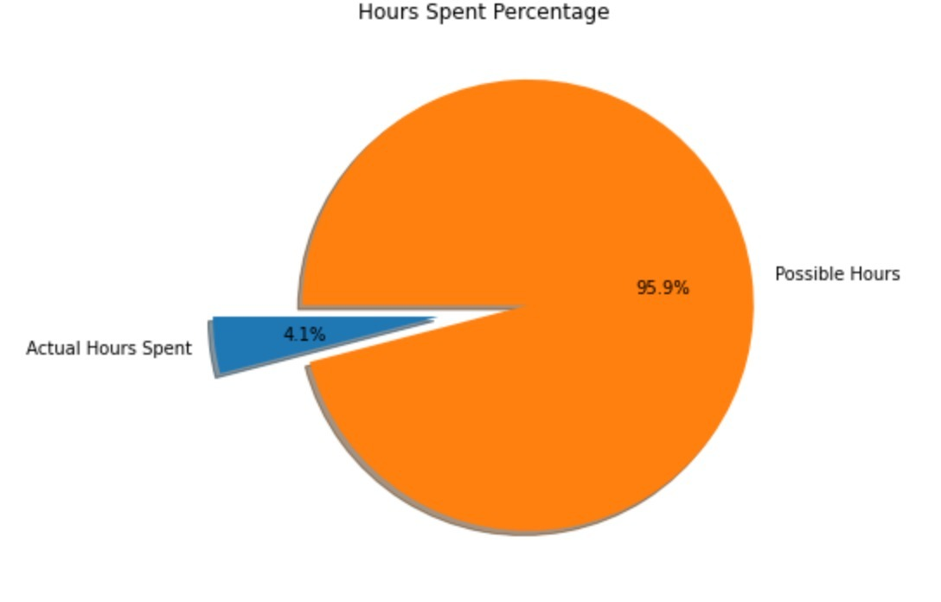
Yoni’s Streaming Times
Notes:
Note: At the back of the logo there’s a loading gif

Slide 16

Song’s Features
Danceability: Describes how suitable a track is for dancing
Energy: Represents energetic tracks that feel fast, loud, and noisy
Valence: Describing the musical positiveness conveyed by a track
Acousticness
Instrumentalness
Liveness
Loudness
AVIRA

Slide 17
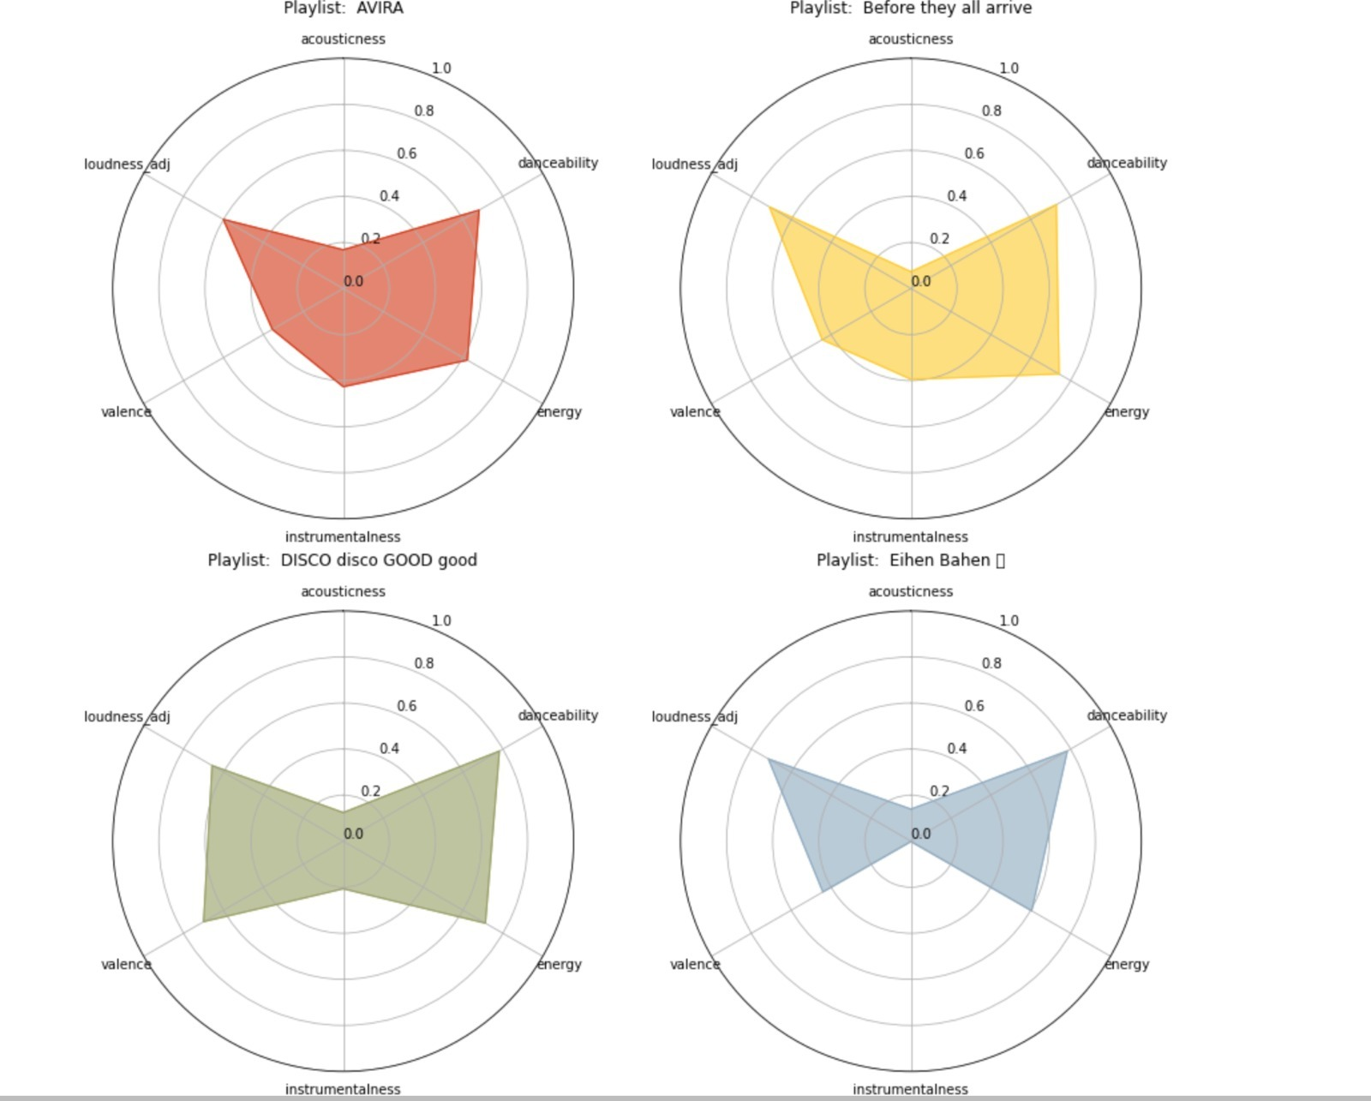
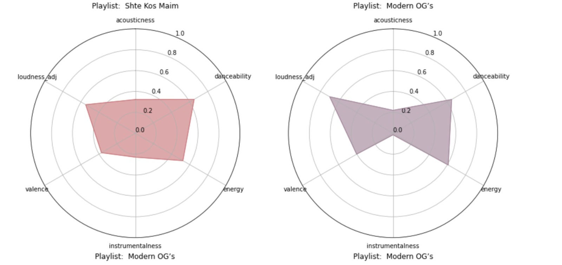
Yoni’s Streaming Playlists Features

Slide 18
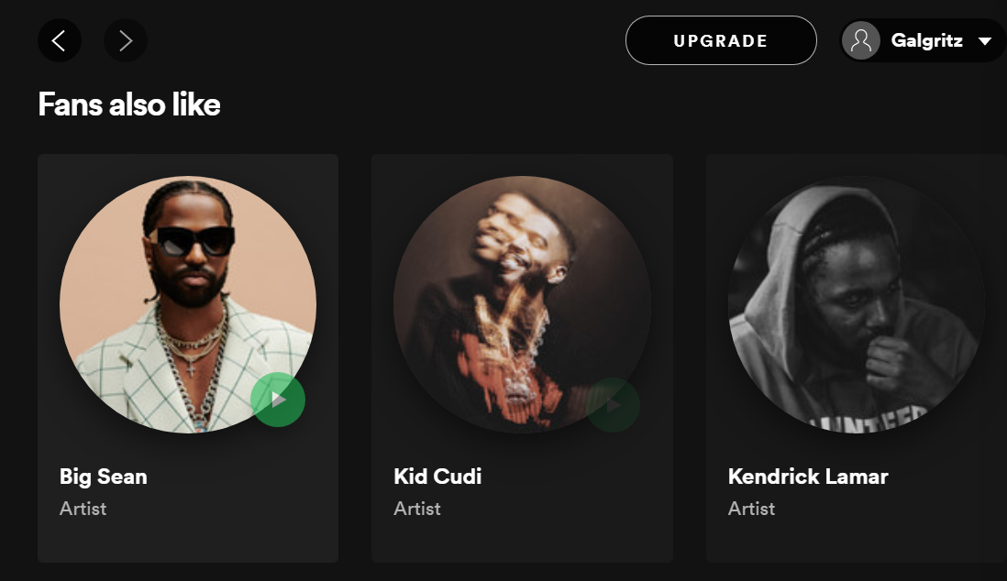
Search
Building our Network
PLAY
FOLLOWING
…
44 artists remaining after filtering
We will define our NODES from 2 sources:
Related artists/fans also like
Core artists
Reporter 1
AVIRA

Slide 19
Search
Building our Network
PLAY
FOLLOWING
…
Our EDGES will be defined by ”Fans also like”
calculating edges weights with:
Genre score
Top songs score
Reporter 1
AVIRA

Slide 20
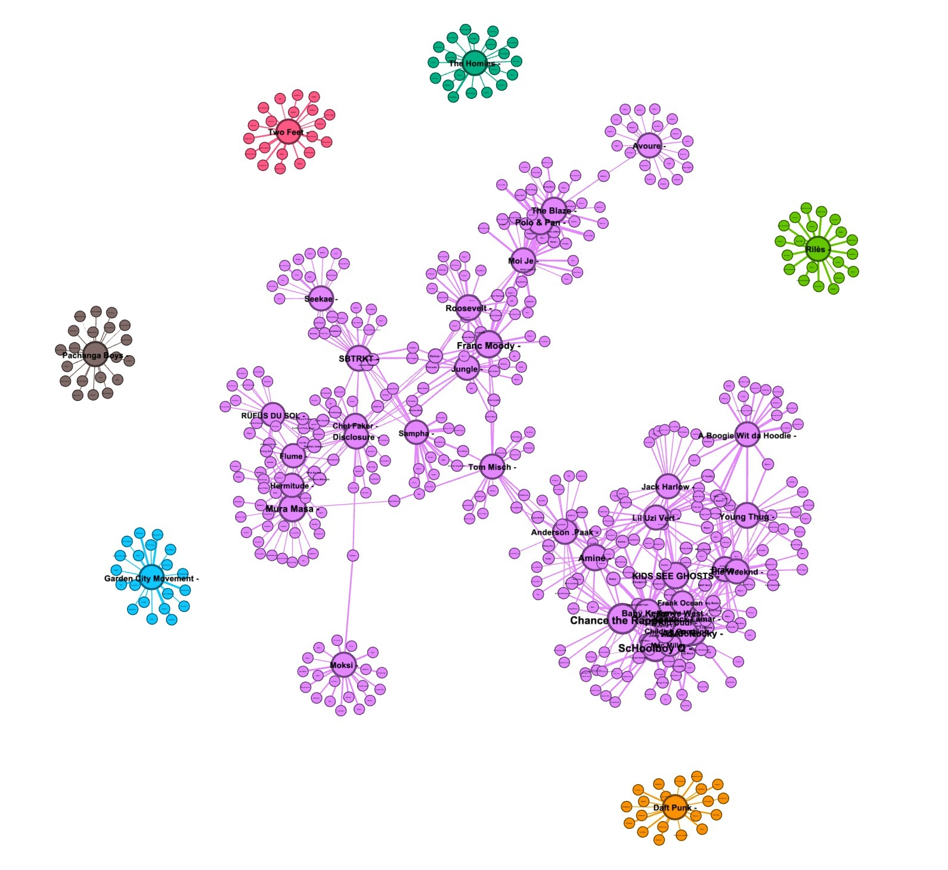
Building our Network
We see 7 components
Our network is not connected
1 significant giant component
Our highest degree ranks belongs to the core artists
We will use only the giant component!

Slide 21
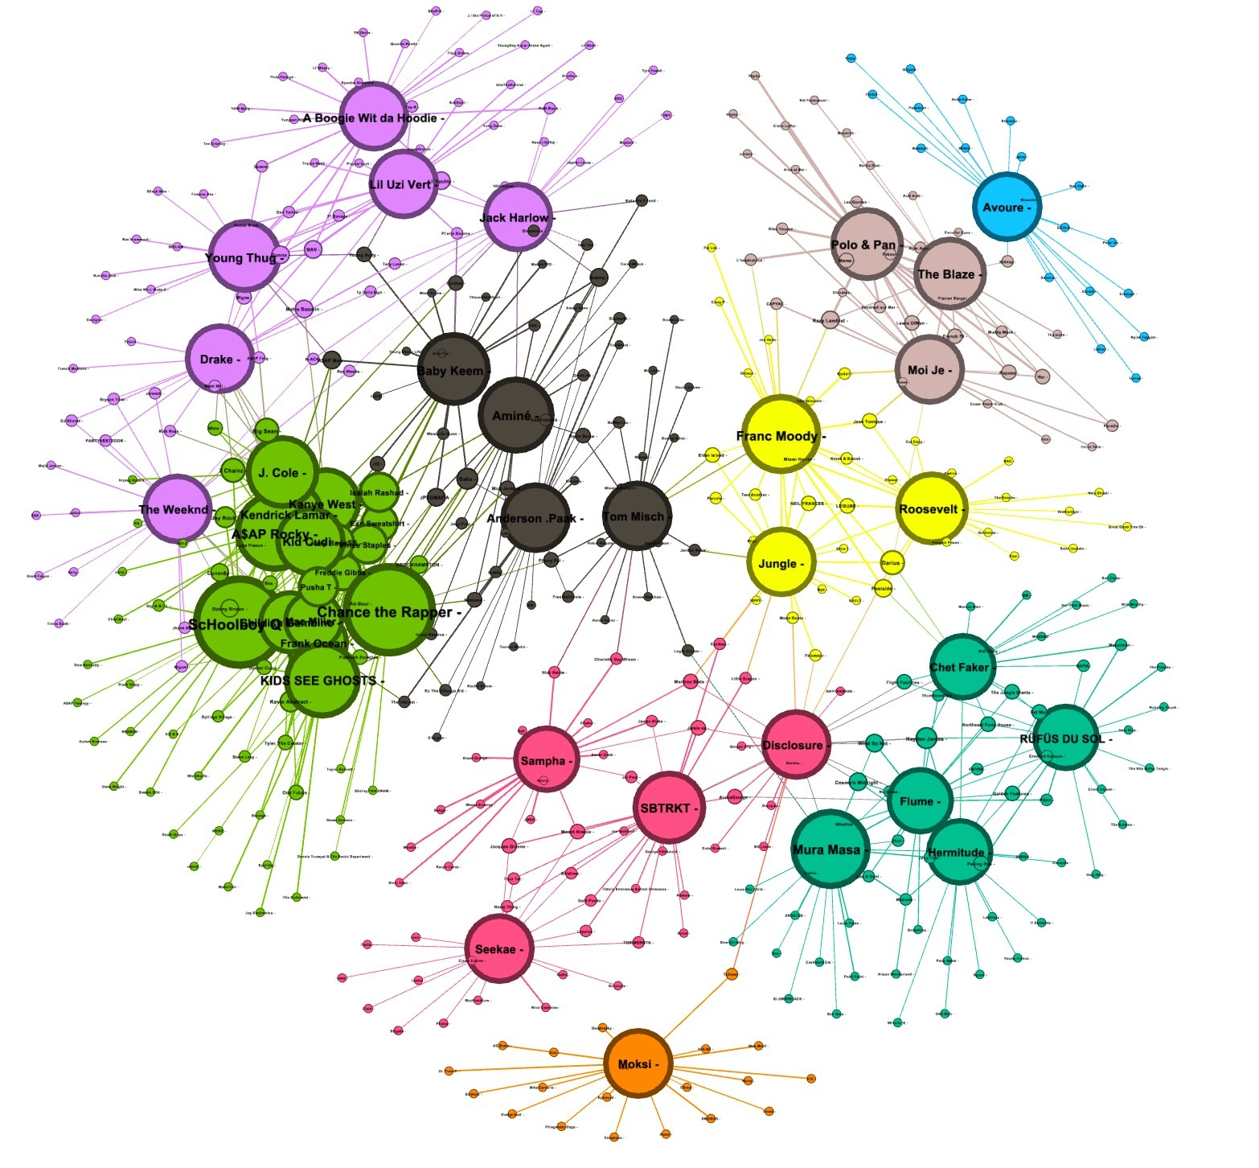
Building our Network
Size of edges by degree
Colors by modularity
**(measures the strength of division of a network into clusters)**

Slide 22
Search
Define Potential New Artists To Listen To
PLAY
FOLLOWING
…
Measures:
Remaining only with related artists (so we not recommend on core artists)
Degree Centrality
Betweenness centrality
Eigenvector centrality
Reporter 1
SHTE KOS MEIM

Slide 23
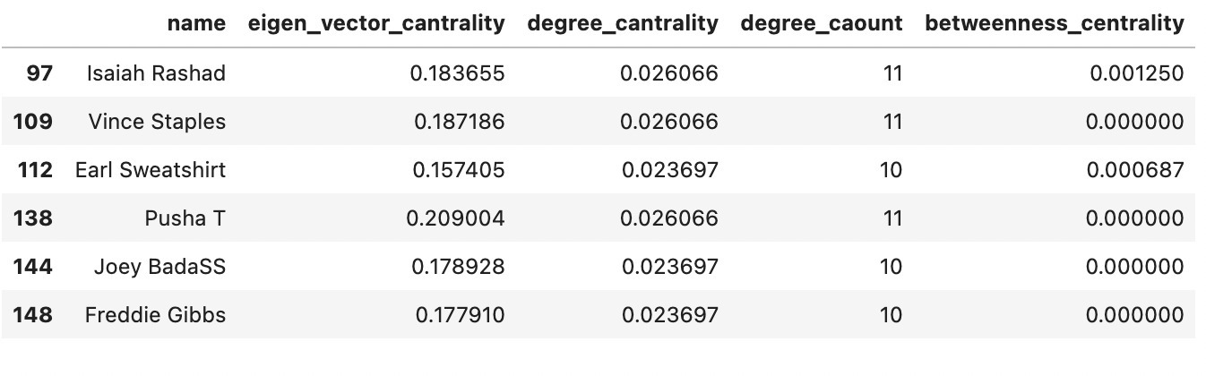
Search
Results - Degree Centrality
The number of links incident upon a node
A node with 10 social connections would have a degree centrality of 10
Reporter 1
SHTE KOS MEIM

Slide 24
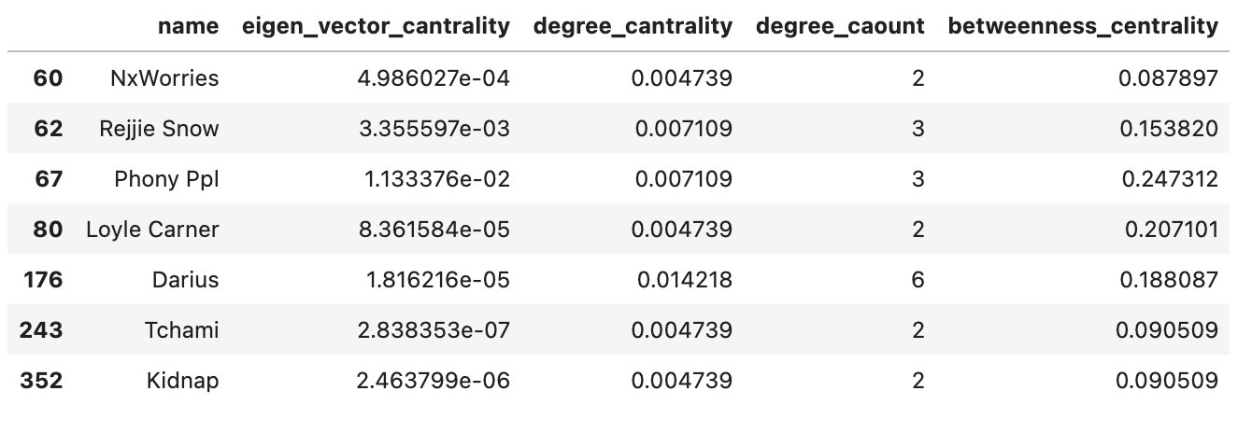
Search
Results - Betweenness Centrality
Captures how much a given node is in-between others.
node will have a high betweenness centrality if it appears in many shortest paths
Reporter 1
SHTE KOS MEIM

Slide 25
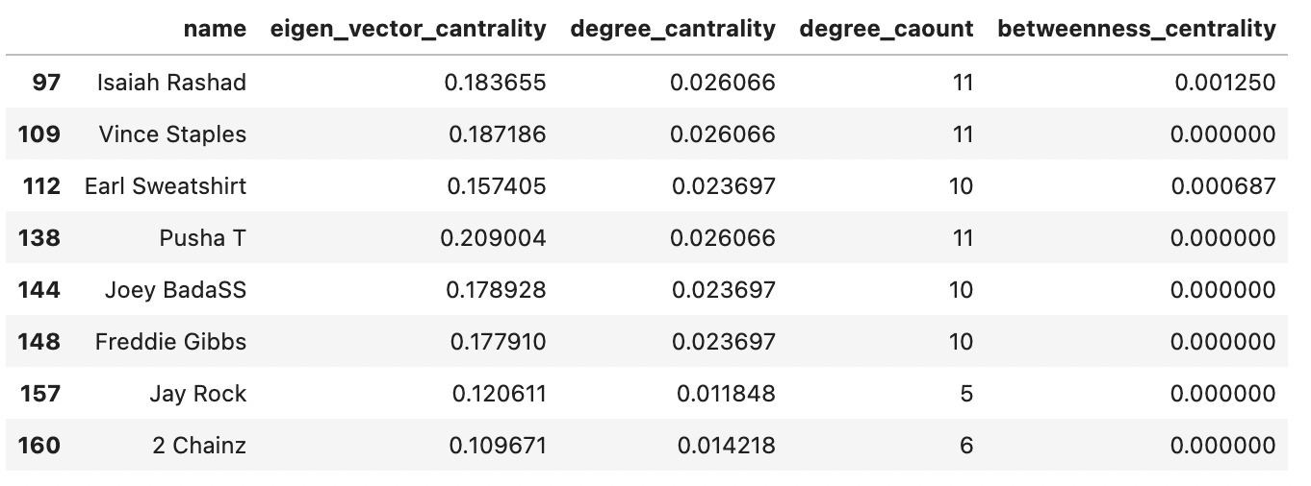
Search
Results – Eigenvector Centrality
Measures a node’s importance while considering the importance of its neighbors
Reporter 1
SHTE KOS MEIM

Slide 26
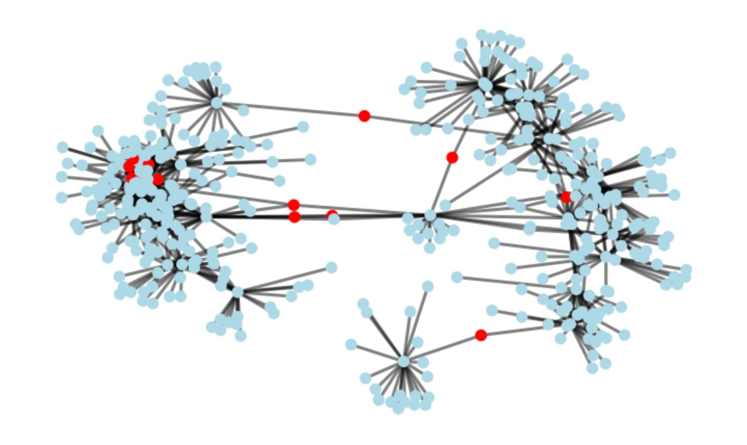
Search
Results
PLAY
FOLLOWING
…
Reporter 1
SHTE KOS MEIM

Slide 27
Conclusions
Using all centrality measures we recommend on 15 artists
Out of our recommendation list Yoni actually liked 9 artists
Yoni has diverse taste in music but sometimes he is a BASIC B
Yoni’s Playlist

Slide 28
Thanks for tuning in

